Slide 1
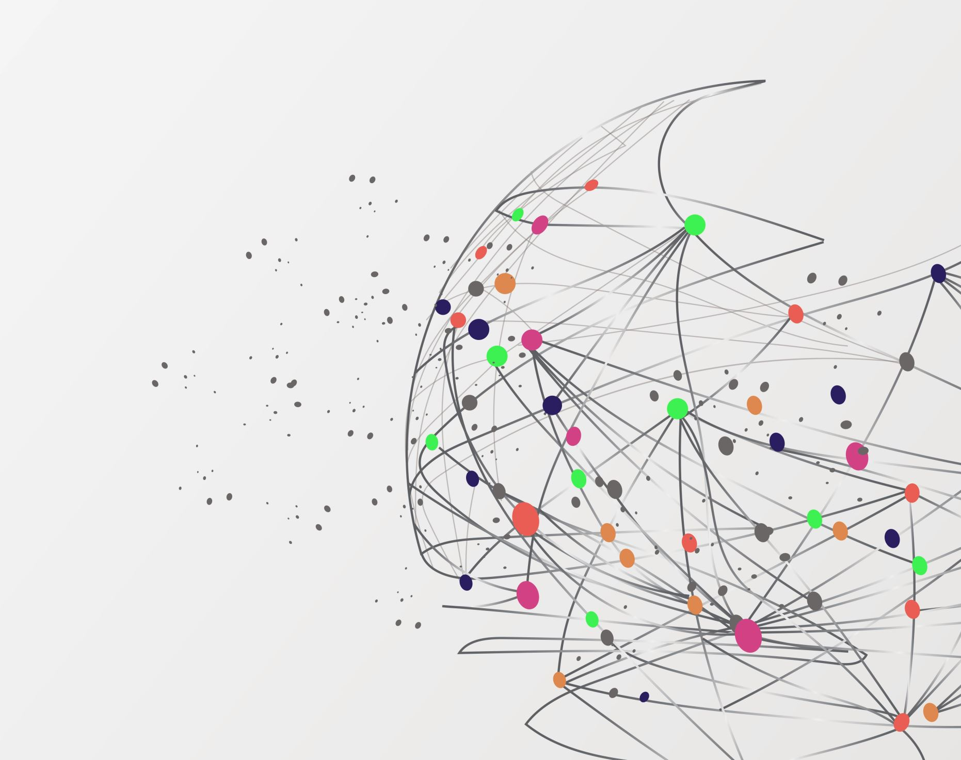
Breast Cancer - Gaussian Naive Bayes Classification
Submitted by Nadav Falkowski

Slide 2
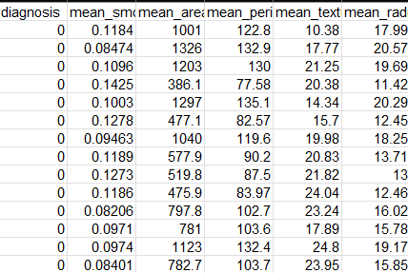
The breast cancer data set:
The data set contains six columns :”mean radius” ,”mean texture”, “mean perimeter”, ”mean area”, “mean smoothness”, “diagnosis”.
The last column - “diagnosis” is the target variable.
The target variable contains two values:
0 = Negative
1 = Positive
The rest of the columns are the features.

Slide 3

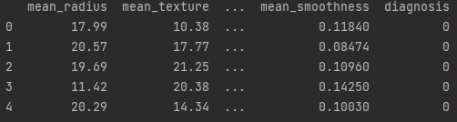
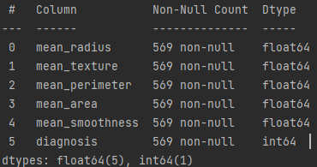
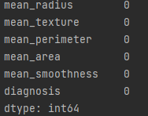
Importation of the data and checking the datatypes
Load the csv file into a data frame
Displays the 5 first rows from the data frame.
Checking the datatypes to see if there’s any need to change them. In this case there’s no need to change them.
Checking there’s any null value. In this case there’s no date missing.

Slide 4
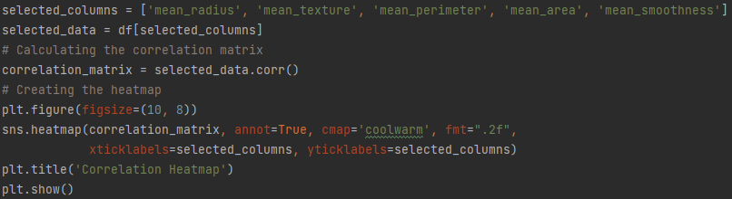
Feature checking:
In Naïve Bayes Classification the features need to be independent.
To check if the features are indeed independent, I use a Seaborn Library to load a heatmap and check the correlation score.

Slide 5
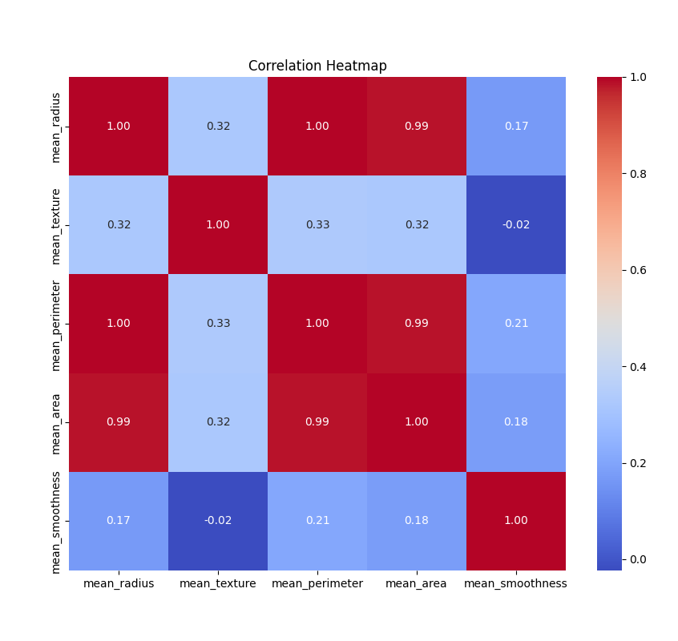
Feature checking:
There are apparent positive correlations in the heatmap. I can assume that the mean area and the mean perimeter are dependent on the radius.
I shouldn't have “mean_area”, “mean_radius”, and “mean_perimeter” in the same data.
Instead, I choose to use – “mean_radius”, “mean_texture”, “mean_smoothness” and “diagnosis.

Slide 6
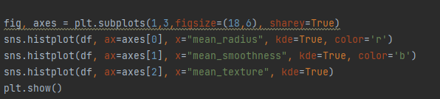
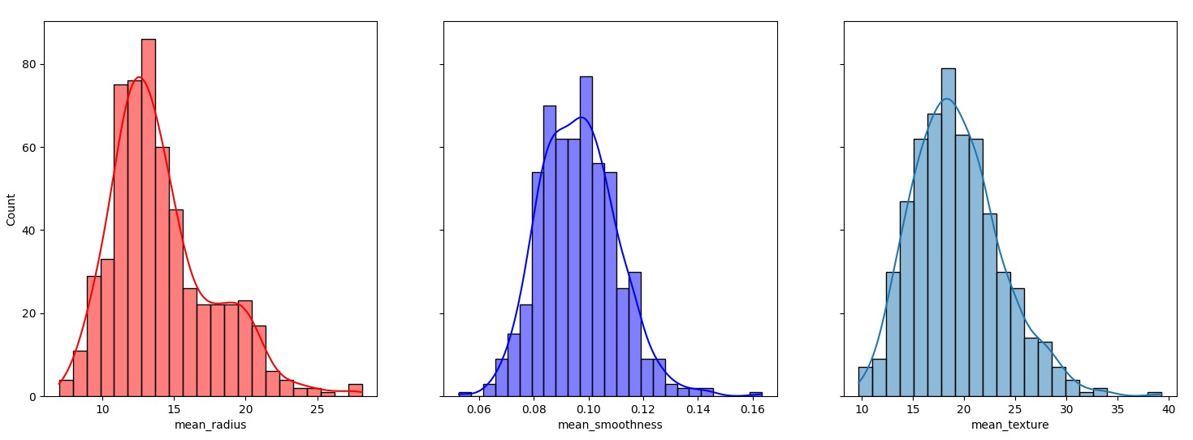
Feature checking:
To get good results I check the distribution of the features by loading “histplot” using the seaborn library :
The distributions are close to normal distributions so I will use these three features.

Slide 7
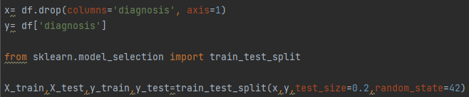
Naïve Bayes Model Training and Testing:
Dividing data into features and labels
Splitting the data into training and tasting dataset, 80% for training and 20% for testing

Slide 8
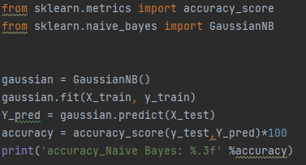
Naïve Bayes Model Training and Testing:
94.737% accuracy!

Slide 9
Challenges:
1. At first, I didn’t know how to start the project, so I started reading about Naïve Bayes Classification and about working with the data set that I chose.
2. I was challenged while checking the features and understanding which feature to use. I needed to learn the different statistical data visualization tools in Python and how to use them.

